Slide 1
TrackPack
Keeping your child safe

Slide 2
Peace of Mind
The TrackPack is a piece of safeguarding technology that is handy and convenient to use and is aimed at parents
Mission
Vision
What we are trying to achieve is a simple and straight forward device that can track a child's location for their safety and reassurance of their parents.
Is to combat the amount of children that are abducted every year and ensure safety of minors
Goals
Values
If this product would be on the market, our goal would be to improve the owners safety and ensure their knows where they are at all times.
This device is straight forward and easy to set up and use. By utilizing the long range, low power wireless communication features of the Explorer, making it ideal for this job.

Slide 3
Reported to phone
First: What is a Fast-Fish? Alive or dead a fish is technically fast, when it is connected with an occupied ship or boat, by any medium at all controllable by the occupant or occupants,—a mast, an oar, a nine-inch cable, a telegraph wire, or a strand of cobweb, it is all the same.
Location on map
The Explorer will ping the co-ordinates every 5 minutes mapping the route of the owner.
Compared with crime stats
First: What is a Fast-Fish? Alive or dead a fish is technically fast, when it is connected with an occupied ship or boat, by any medium at all controllable by the occupant or occupants,—a mast, an oar, a nine-inch cable, a telegraph wire, or a strand of cobweb, it is all the same.

Slide 4
Our Services
Write something in this section
First: What is a Fast-Fish? Alive or dead a fish is technically fast, when it is connected with an occupied ship or boat, by any medium at all controllable by the occupant or occupants,—a mast, an oar, a nine-inch cable, a telegraph wire, or a strand of cobweb, it is all the same. Likewise a fish is technically fast when it
Service Name
Service Name
Service Name
A telegraph wire, or a strand of cobweb,
A telegraph wire, or a strand of cobweb,
A telegraph wire, or a strand of cobweb,
Service Name
Service Name
Service Name
A telegraph wire, or a strand of cobweb,
A telegraph wire, or a strand of cobweb,
A telegraph wire, or a strand of cobweb,
Service Name
Service Name
Service Name
A telegraph wire, or a strand of cobweb,
A telegraph wire, or a strand of cobweb,
A telegraph wire, or a strand of cobweb,

Slide 5

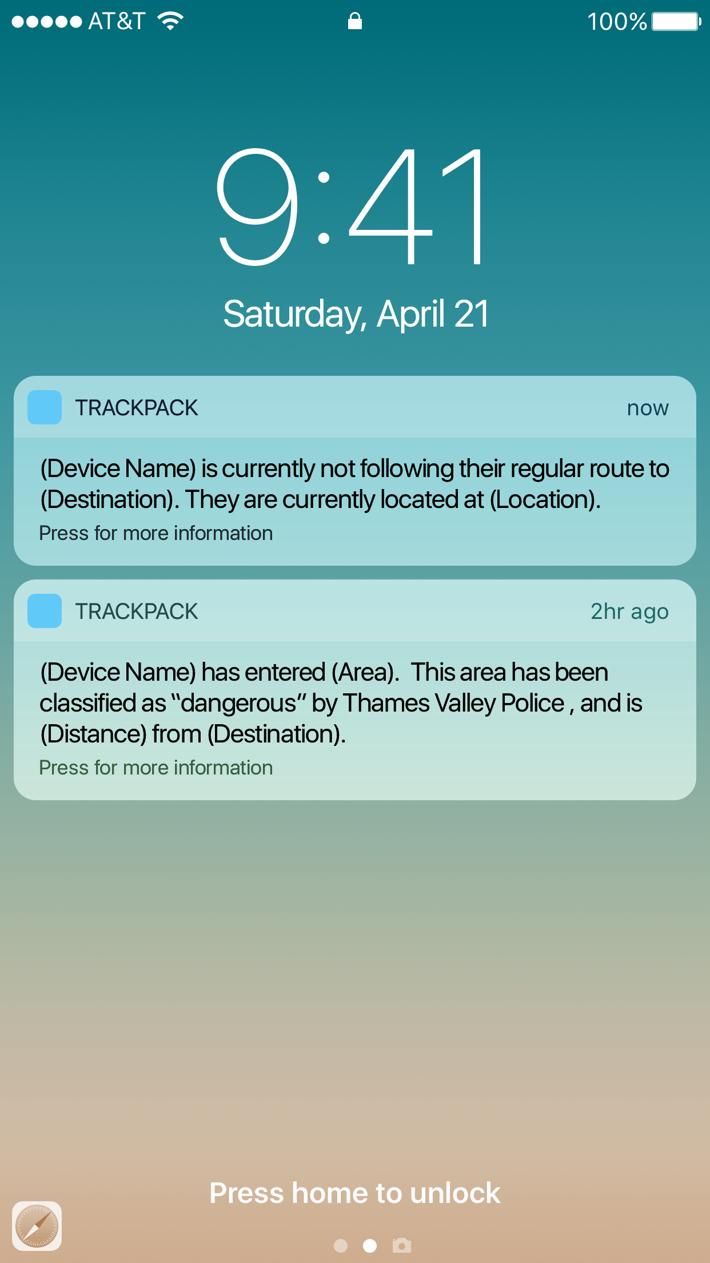
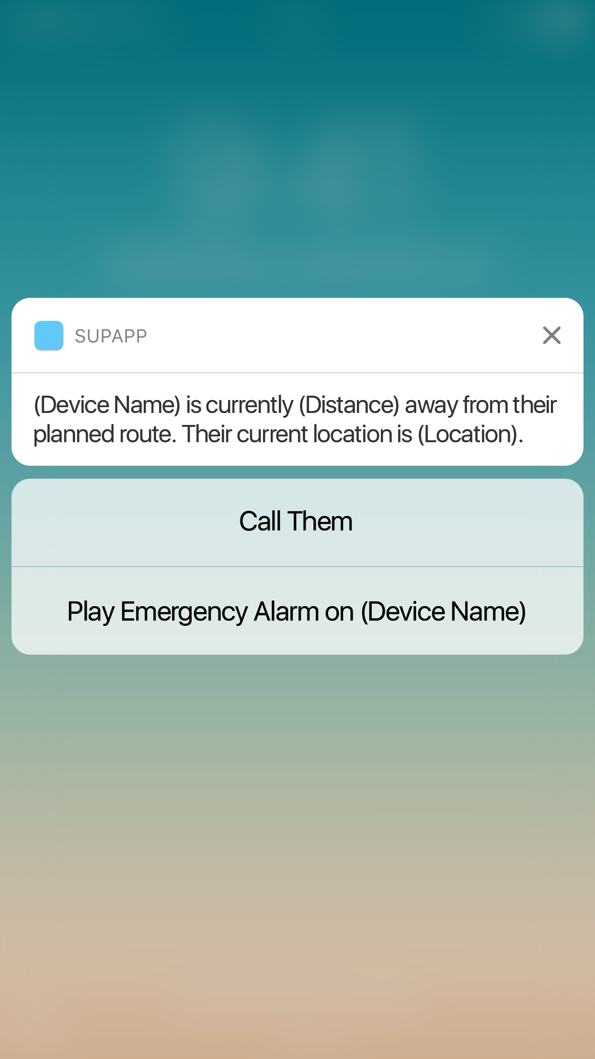
iPhone Mockup Included
Write something in this section
First: What is a Fast-Fish? Alive or dead a fish is technically fast, when it is connected with an occupied ship or boat, by any medium at all controllable by the occupant or occupants,—a mast, an oar, a nine-inch cable, a telegraph wire, or a strand of cobweb, it is all the same. Likewise a fish is technically fast when it bears a waif, or any other recognized symbol of possession; so long as the
First: What is a Fast-Fish? Alive or dead a fish is technically fast, when it is connected with an occupied ship or boat
First: What is a Fast-Fish? Alive or dead a fish is technically fast, when it is connected with an occupied ship or boat
First: What is a Fast-Fish? Alive or dead a fish is technically fast, when it is connected with an occupied ship or boat

Slide 6
WRITE A TITLE IN THIS SECTION
Get in Touch
With Us
A telegraph wire, or a strand of cobweb, it is all the same. Likewise a fish is technically fast when it bears a waif, or any other recognized
Send us a message or visit us
Whenever you like
Empire State Building
350 5th Ave, New York, NY 10118
(212) 736-3100

Slide 7

Download More Templates

